Slide 1
Comparison of GDSC-predicted drug-gene interactions with known drug targets
Joseph Starkey
Supervisor: Nick Hay
Co-Supervisor: Frances Pearl

Slide 2
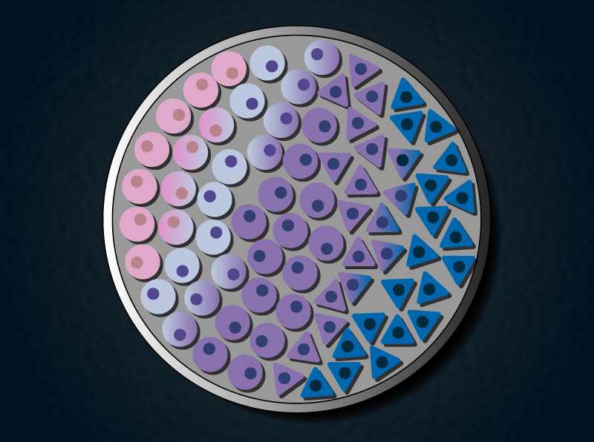
Cell Line Data
Gene Essentiality: DepMap
CRISPR-derived experiments producing scores indicating how essential for survival each gene is within a given cell line
Drug Response: GDSC
Experiments giving IC50 and/or eMax response of each cell line to different pharmacological drugs

Slide 3

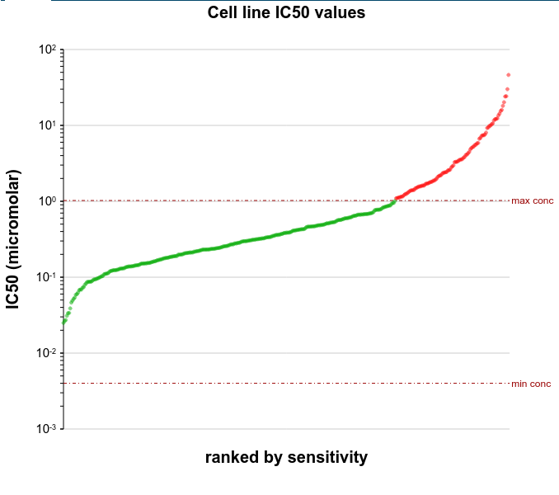
GDSC
Genomics in Drug Stability and Cancer
Database of results treating over 1000 cancer cell lines with over 500 pharmacological substances
  Includes cytotoxic chemotherapeutics and targeted therapeutics from commercial and academic sources
Cited by over 3,000 papers since its release in 2013
Measures sensitivity of cell lines to each drug, i.e. effect of drug on cell survivability of each cell line
GDSC2 is an updated database with more drugs tested and better controls
GDSC² is a subsequent project which repeats these tests while applying 2 different drugs simultaneously to these Cell Lines
Sensitivity of genes to A-443654, taken from GDSC website

Slide 4
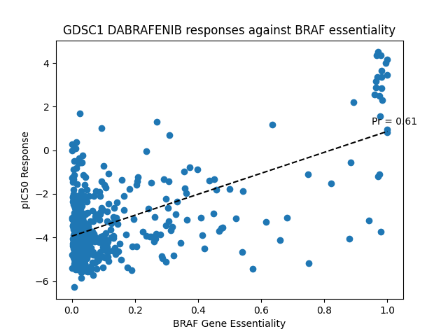
Survivability Correlation
Work by Laurence Pearl
  GDSC gives information on drug concentration effect on cell line survivability
  L.P. code considers genes mutated in each cell line to calculate ‘survivability correlation’ for each drug against each gene
  Higher drug-gene survivability correlation → that gene being wild-type is more important for cell survival when exposed to that drug
Provides distributions of drug-gene interactions (as well as gene-drug interactions)
Most are unimodal/Gaussian distributions, but there are some multimodal
Allows for calculation of ‘threshold survivability’ values to determine apparent strong drug-gene targets

Slide 5
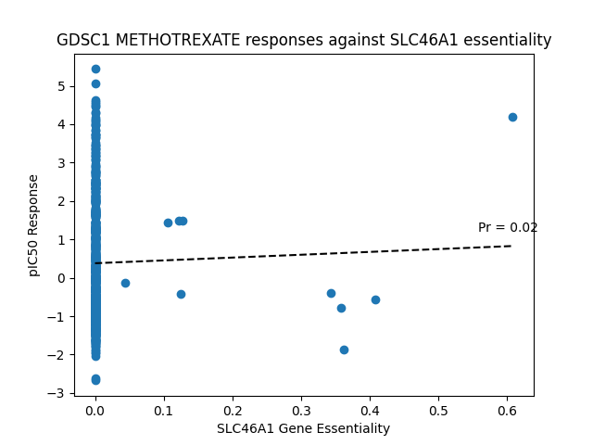
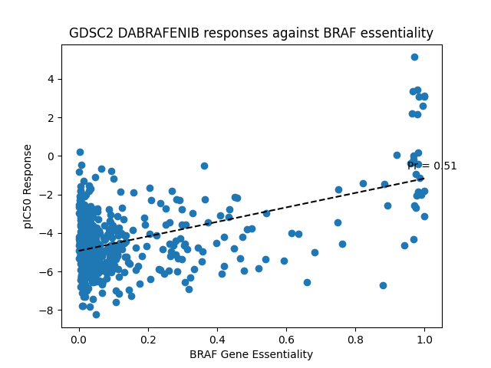
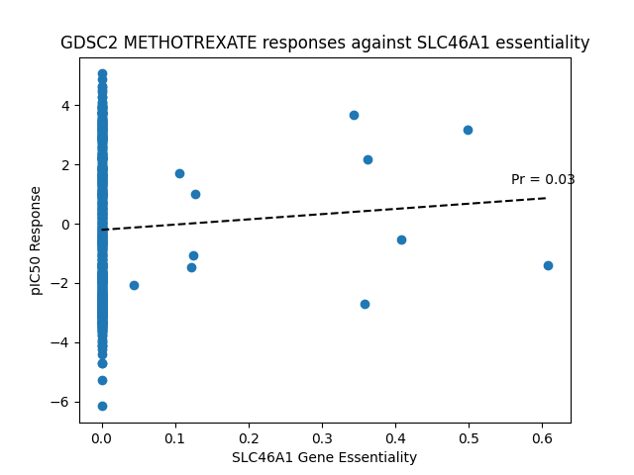
Essentiality-Response Comparison

Slide 6
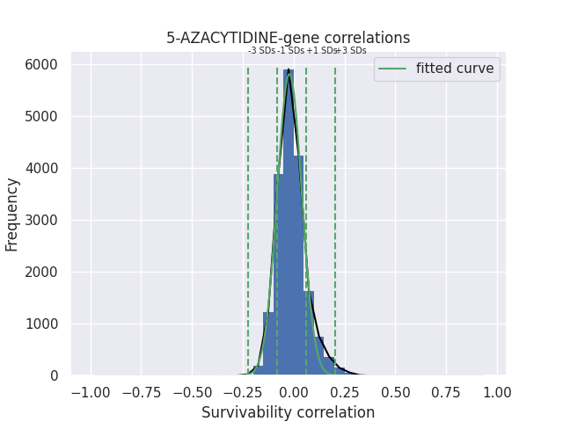
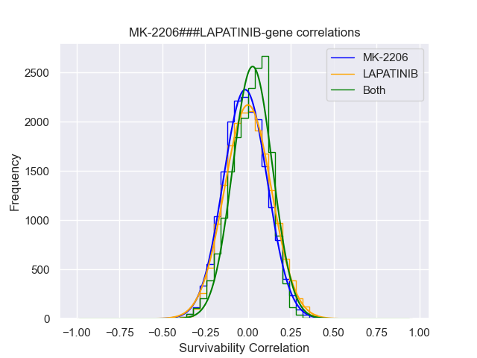
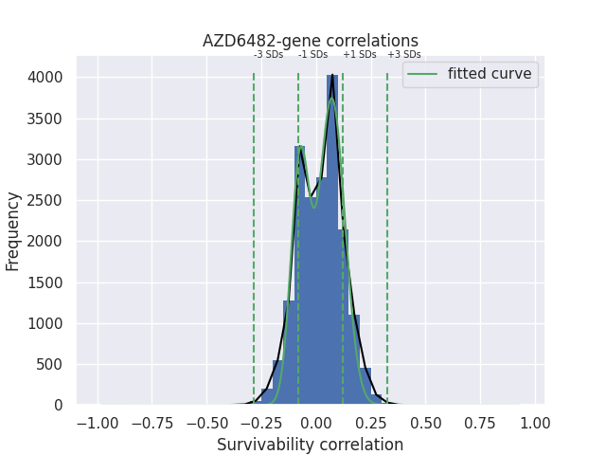

Slide 7
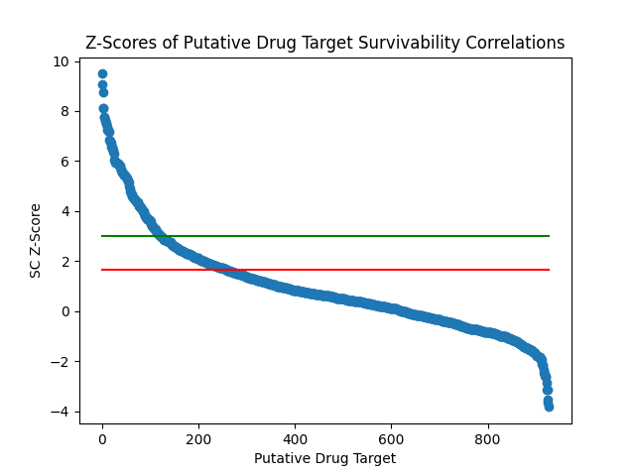
Target Predictability

Slide 8
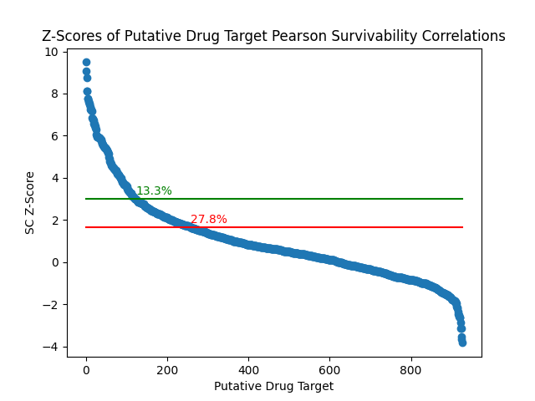
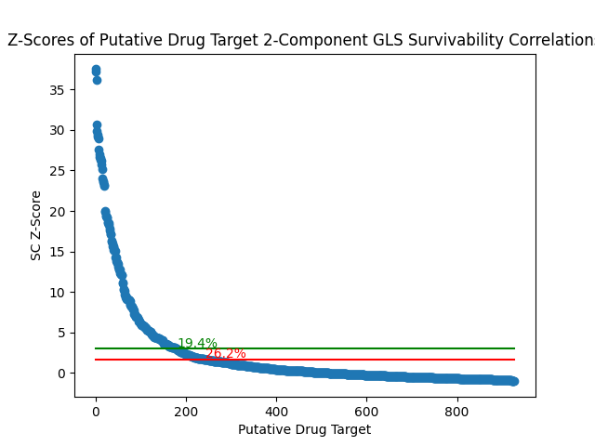
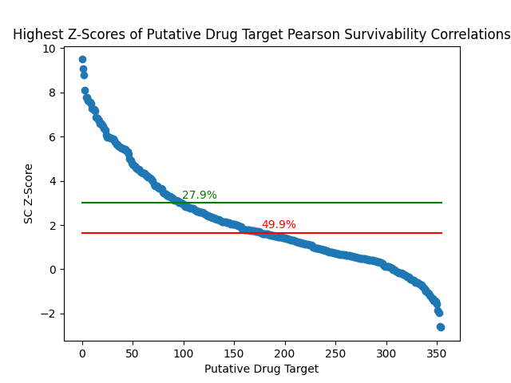
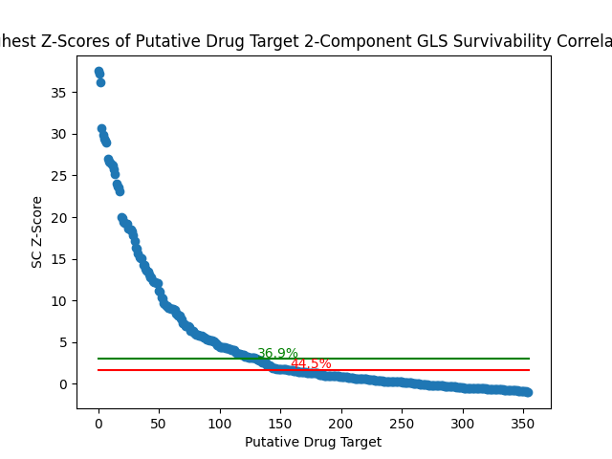
Z-Scores Expanded

Slide 9
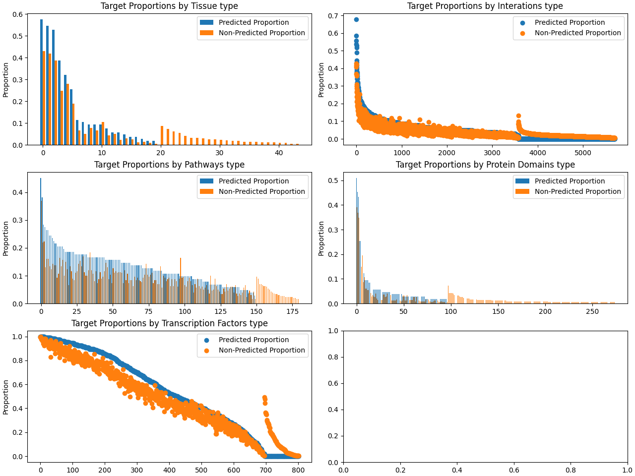
Gene Target Properties Analysis

Slide 10
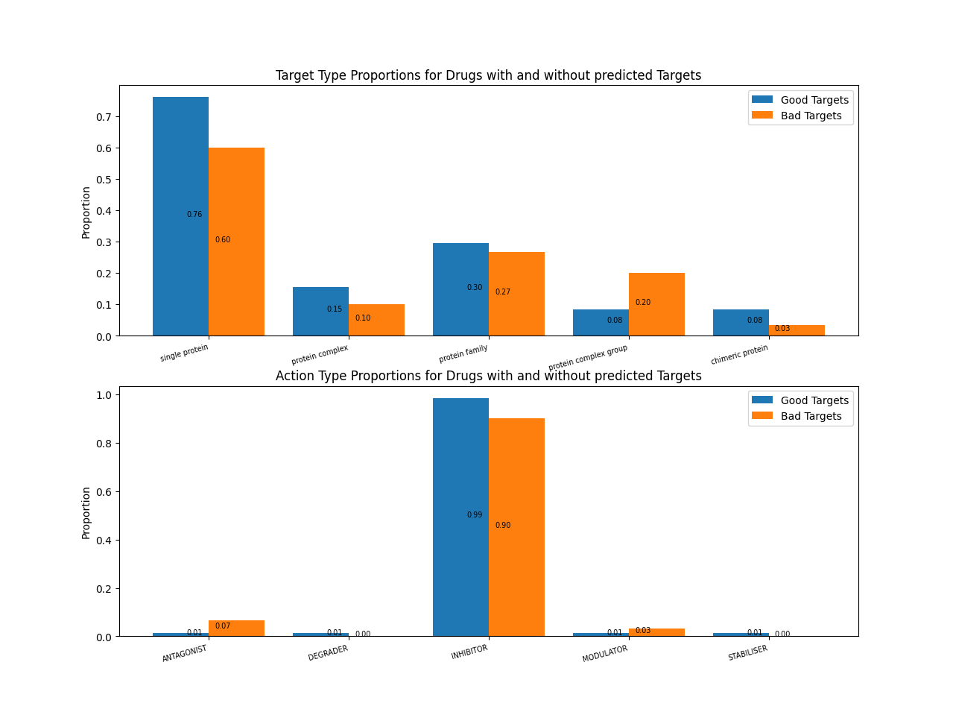
Drug Action Analysis

Slide 11
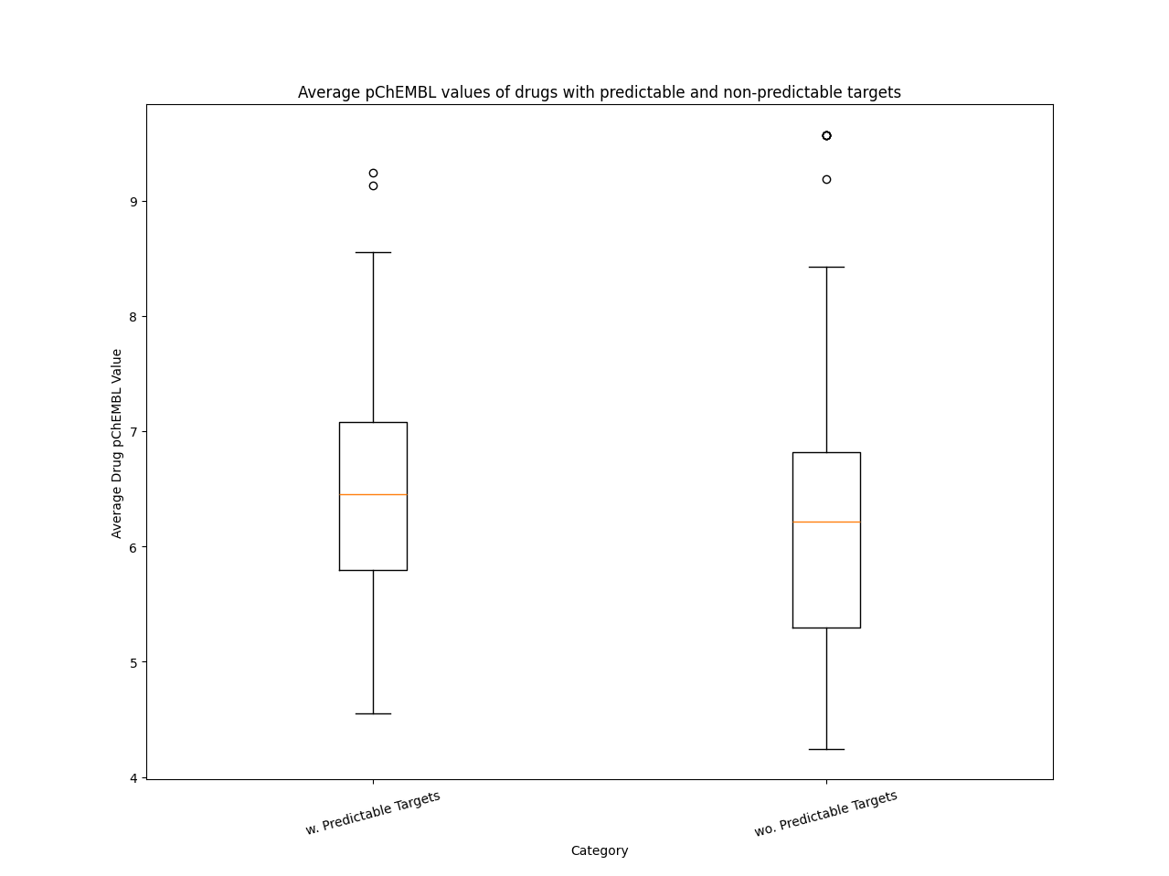
pChEMBL Comparison

Slide 12
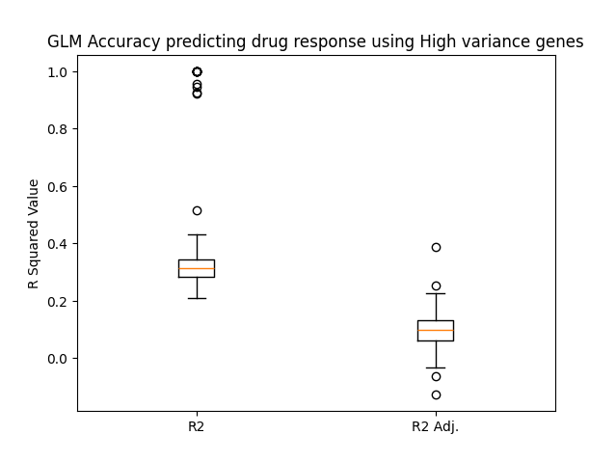
GLM Prediction

Slide 13
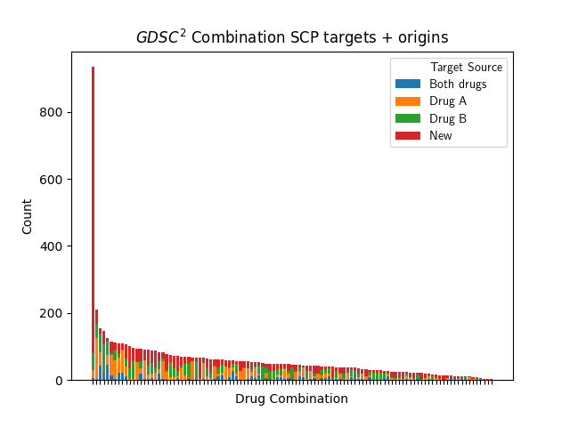
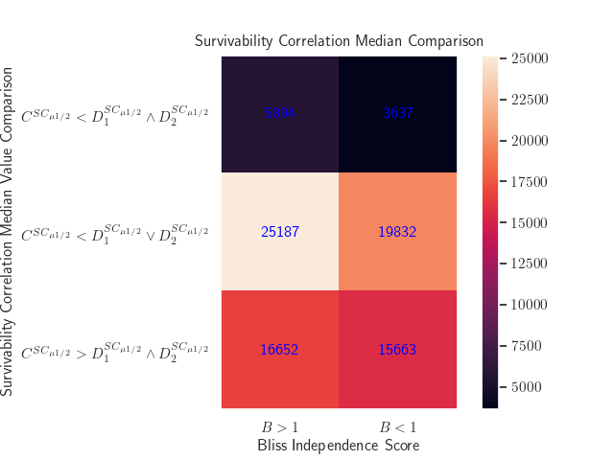

Slide 14
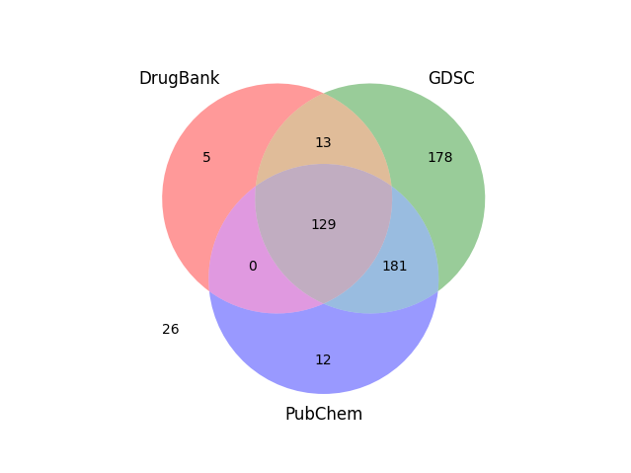
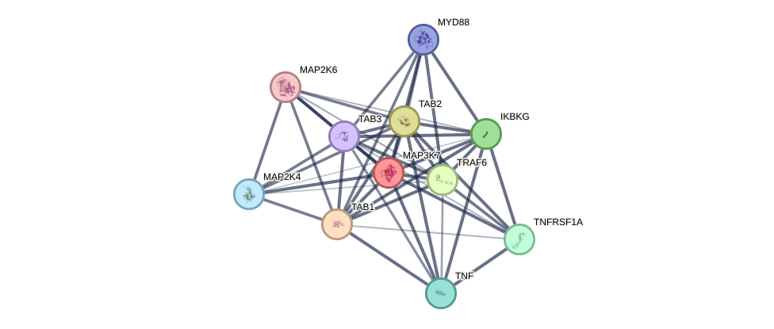
Target Investigation
Comparing predicted ‘strong’ targets/interactions from our GDSC-based ‘survivability correlation’ with official targets provided by internal and external databased
GDSC provides known gene targets for some drugs, PubChem identifiers for some, and some are contained within DrugBank
  26 substances with no targets nor external identifiers given which appear to be internal residues tested by GDSC
Next Steps:
Compare GDSC and GDSC² IC50 single-drug results
Investigate known gene targets in comparison to survivability-correlation-predicted strong targets
Investigation of PPI/gene interaction pathways for targets not predicted by GDSC and other outliers

